Slide 1

Statistical Testing
Lauren Vanderlinden, PhD, MS
T15 Postdoctoral Fellow Computational Biology
Division of Rheumatology & Department of Biomedical Informatics
School of Medicine, University of Colorado Anschutz Medical Campus
CPBS 7602 - November 27, 2024

Slide 2
Outline
Inference
Populations and sampling
Study designs
Directed acyclic graphs (causal diagrams)
Hypothesis testing
Effect sizes and p-values
Power and type II error rate
Bayesian statistics

Slide 3
Inference

Slide 4
Inference
An inference is a conclusion that patterns in the data (sample) are present in a larger context (population).
Observation
Inference
Out of the 8 students in this class,
6 hate statistics
75% of all graduate students hate statistics

Slide 5
Types of Inference
Statistical inference is an inference justified using statistical methods.
Scope of inference is the group of objects to which my conclusion (results) extend.
Causal inference is drawing a cause-and-effect conclusion between an explanatory variable and a response variable.

Slide 6
Statistical Inference
Inference

Slide 7
Statistical Inference
Statistical inference is an inference justified using statistical methods.
Statistical inference allows us to quantify the uncertainty in our conclusions.
Observation
Statistical Inference
It is probable that at least 60% and less than 90% of all graduate students hate statistics
Out of the 8 students in this class,
6 hate statistics

Slide 8
Scope of Inference
Inference

Slide 9
Populations & Samples
Researchers are typically interested in finding results that apply to an entire population of people or things.
Population
The collection of units (be they people, plankton, plants, cities, suicidal authors, etc.) to which we want to generalize a set of findings or a statistical model.
Sample
A smaller (but hopefully representative) collection of units from a population used to determine truths about that population.

Slide 10
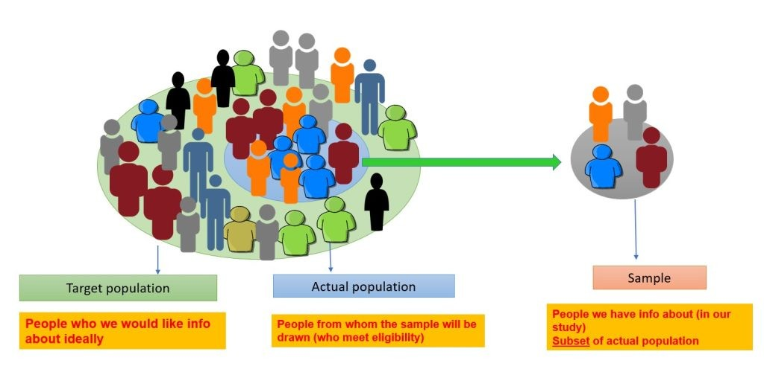
Sampling Figure
https://www.linkedin.com/pulse/population-sample-statistics-alka-pandey/

Slide 11
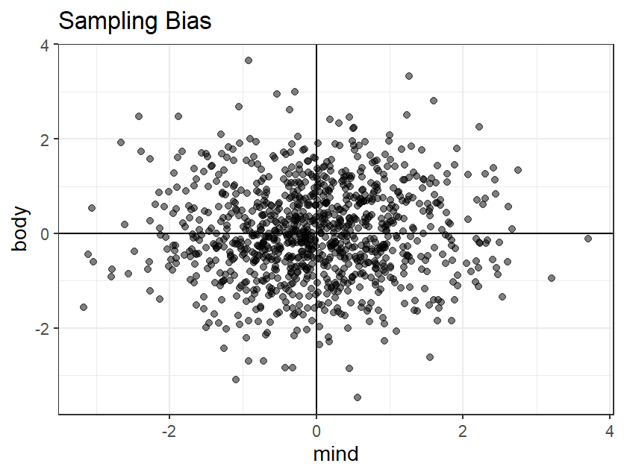
Sampling Gone Wrong
If good looks and smarts are distributed normally
If good looks and smarts have nothing to do with each other
http://euri.ca/2012/youre-probably-polluting-your-statistics-more-than-you-think/index.html
http://www.theatlantic.com/business/archive/2012/05/when-correlation-is-not-causation-but-something-much-more-screwy/256918/

Slide 12
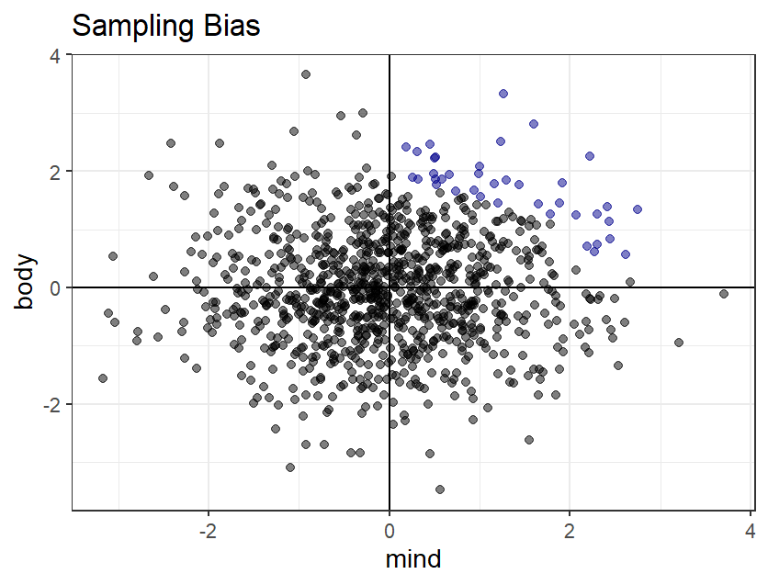
Sampling Gone Wrong
If good looks and smarts are distributed normally
If good looks and smarts have nothing to do with each other
If movie producers want both smarts and looks. Then, by observing employed actors (blue) we’ll assume that looks and smarts have a negative correlation
http://euri.ca/2012/youre-probably-polluting-your-statistics-more-than-you-think/index.html
http://www.theatlantic.com/business/archive/2012/05/when-correlation-is-not-causation-but-something-much-more-screwy/256918/

Slide 13
Selection Bias
Bias results when different types of people have different probabilities of getting into the study, or staying in the study
Participants have different probabilities of being included or retained in a study based on their exposure and/or disease status
The sample obtained is not representative of the population to which we would like to generalize the results

Slide 14
Scope of Inference
The scope of inference is the group of individuals to whom the statistical conclusions can be extended.
Inferences to populations can be only drawn from random sampling studies.
A random sampling study is when units are randomly selected from a well-defined population.
Random sampling typically ensures that all subpopulations are represented in the sample in roughly the same proportion as the population.
Our statistical procedures take into account that sometimes the sample may not be a very good mix of the population.

Slide 15
Causal Inference
Inference

Slide 16
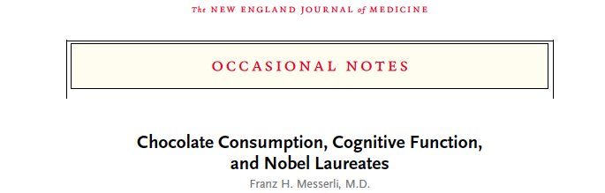
“Switzerland was the top performer in terms of both the number of Nobel laureates and chocolate consumption. The slope of the regression line allows us to estimate that it would take about 0.4 kg of chocolate per capita per year to increase the number of Nobel laureates in a given country by 1. For the United States, that would amount to 125 million kg per year. The minimally effective chocolate dose seems to hover around 2 kg per year, and the dose–response curve reveals no apparent ceiling on the number of Nobel laureates at the highest chocolate-dose level of 11 kg per year.”

Slide 17
Types of Studies
Experiments are studies in which we manipulate one or more explanatory variables (e.g., treatments) to see the effect they have on another variable.
In a randomized experiment the investigator uses a chance mechanism to assign experimental units to various treatment groups
Observational studies are studies in which the data are measured through observation of the world as it naturally occurs.
Grouping (i.e., explanatory variable) occurs naturally and is not assigned

Slide 18
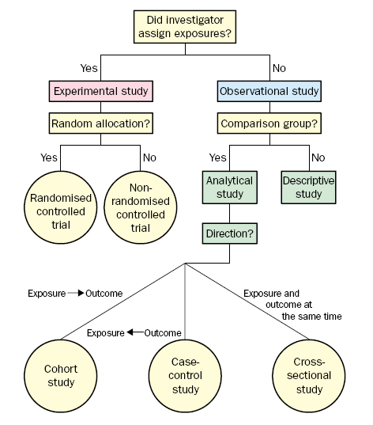
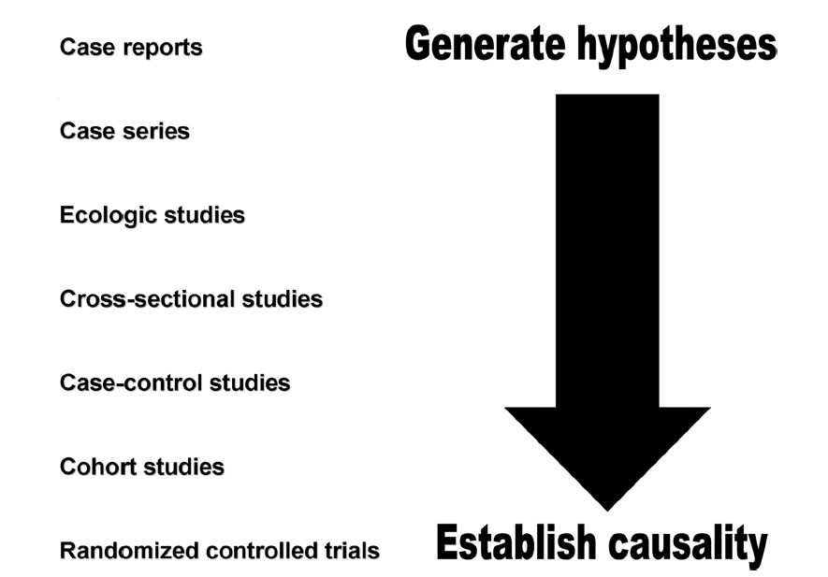
Grimes et al. Lancet 2002;359:57-61

Slide 19
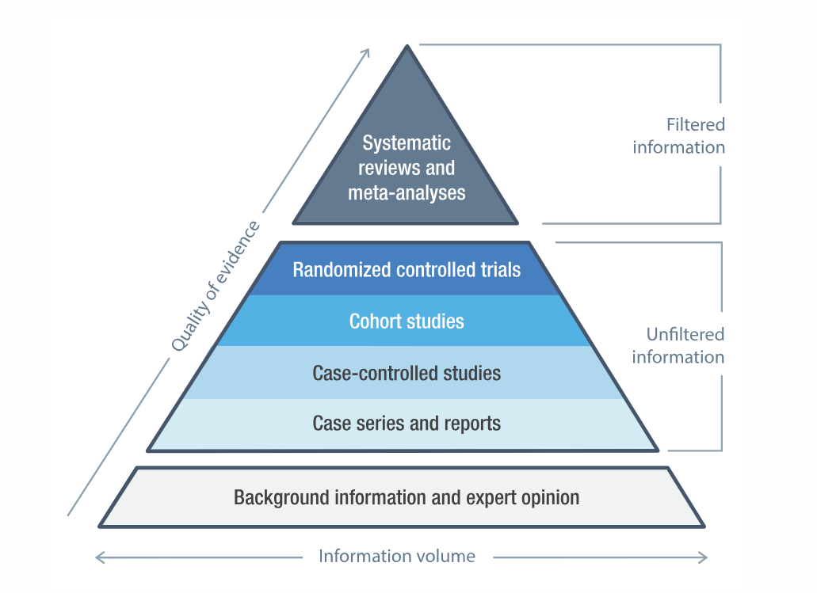
Levels of Evidence
https://openmd.com/guide/levels-of-evidence

Slide 20
Causal Inference & Observational Studies
Causal inference is impossible in observational studies because confounding variables may cause the differences in the behavior of the response variable for different groups.
A confounding variable is a variable that explains the group a person (e.g. exposure) is in and also the outcome of interest.
e.g., health consciousness is a confounding variable when testing the relationship between takes vitamins and how often a person gets sick

Slide 21
Confounding Example
Predictor
Smoking
Outcome
Forced Expiratory Volume (FEV)
https://askgoodquestions.blog/2020/03/02/35-statistics-of-illumination-part-4/

Slide 22
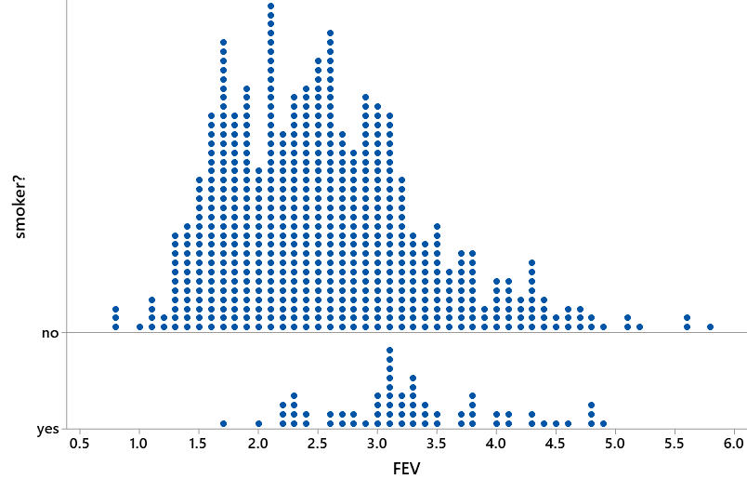
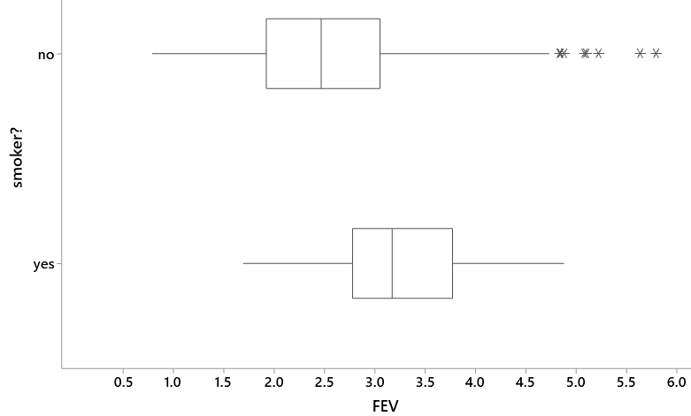
Confounding Example
Conclusion: Smokers have Increased Lung Capacity
https://askgoodquestions.blog/2020/03/02/35-statistics-of-illumination-part-4/

Slide 23
Confounding Example
Confounding Variable
Age
Predictor
Smoking
Outcome
Forced Expiratory Volume (FEV)
https://askgoodquestions.blog/2020/03/02/35-statistics-of-illumination-part-4/

Slide 24
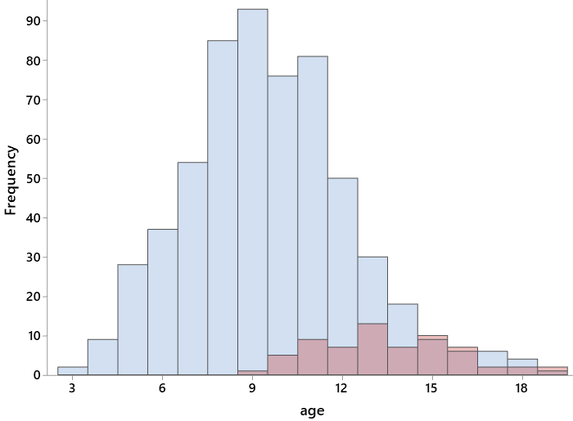
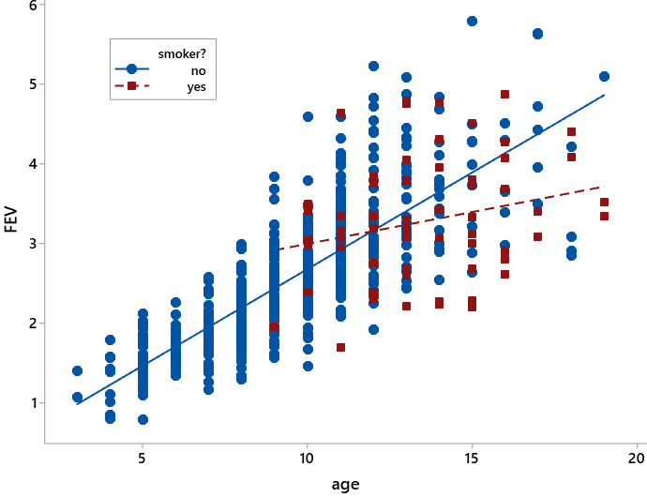
Confounding Example
https://askgoodquestions.blog/2020/03/02/35-statistics-of-illumination-part-4/

Slide 25
Causal Inference & Randomized Studies
Causal inference can be made from randomized experiments but not from observational studies.
Randomization ensures that subjects with different features (i.e., confounding variables) are mixed up evenly among the treatment groups
Randomized experiments seek to create groups that are totally similar except whether a treatment/exposure is present or absent
The possibility that the groups may not end up being very “random” (i.e., groups are not mixed very well) is incorporated into the statistical tools used to express our uncertainty

Slide 26
Causal Diagrams

Slide 27
Directed Acyclic Graphs (DAGs)
Another way to illustrate sources of bias (e.g., confounding) and other threats to validity (e.g., selection bias, measurement error)
Visualize direction and flow of association (both causal and non-causal)
Summarizes and informs the analytical approach
Keeps you anchored to your research question
If interested in building your own DAG: https://www.dagitty.net/

Slide 28
DAG Components
Components of a DAG
Confounder
Precision Covariate
Mediator
Effect modifier
Collider

Slide 29
DAG Backbone
Exposure (E)
Outcome (D)
Cause
Risk factor
Antecedent event
Ancestor
Treatment
Independent variable
Predictor
Correlate
Determinant
Explanatory variable
X-variable
Effect
Disease
Event
Result
Case status
Dependent variable
Y-variable

Slide 30
No Feedback Loops
Directed Acyclic Graphs
E
D
We know in biological systems there are many feedback loops
Way to think about these variables in DAG form would be to specify a time (e.g. variable at time A, B…)

Slide 31

Basic elements of a DAG
& how they relate to causal inference
Accounting for these variables promotes exchangeability between exposed & unexposed groups, and enhances internal validity
Accounting for confounders controls bias; accounting for precision covariates controls for measurement error
Confounder
Precision covariate
Mediator
Effect modifier
Collider
✓
Maybe
Whether you deal with these types of variables in an analysis depends on your research question
Colliders present a selection bias issue
Conditioning on a collider is a threat to both internal and external validity

Slide 32
Confounder
A variable that is associated with the exposure (but not affected by the exposure), and a potential determinant of the outcome.
“A shared common cause of E and D.”
E
D
Confounder
Notes:
One of the purposes of DAGs is to help us identify open paths between the E and D, because these can tell us about other variables that might bias the relationship of interest.

Slide 33
Confounder Example
Positive association – why?
Exposure
Outcome
Eating ice cream
Drowning
Season
Confounder

Slide 34
Confounder Example
Positive association between eating ice cream and drowning
# Cases of drowning per week
Eating ice cream

Slide 35
Confounder
Spring
No association between eating ice cream and drowning after conditioning on season
Summer
Fall
Drowning
Winter
Eating ice cream

Slide 36
Precision covariate
Variable that accounts for variability (i.e., measurement error) in the exposure only, or the outcome only.
E
D
Prec. cov. (P₁)
Prec. cov. (P₂)
Notes:
Age, time of sample collection, etc
*ASSUMPTION: precision covariates are not associated with your confounders

Slide 37
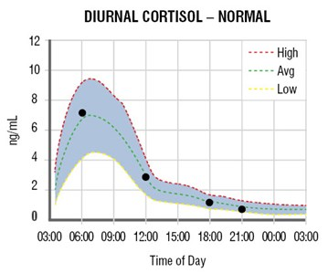
Precision covariate
Question: Is higher salivary cortisol associated with depression?
Exposure
Salivary cortisol
Outcome
Depression
What to do in an analysis?
Consider adjusting for it in the analysis
If adjustment does not make a difference in the estimate of interest, better to not include it in the models
Time of day of saliva collection
Precision cov.

Slide 38
Mediator
A variable on the causal pathway between the exposure and outcome (i.e., caused by the exposure and a possible determinant of the outcome; also known as an intermediate variable)
Direct path
E
Mediator
D
Indirect path
Notes:
Be wary of how you adjust for EMs that occur after the exposure

Slide 39
Mediator Example
Exposure
Mediator
Outcome
Fish Oil Supplements
Resolvin 5D
Rheumatoid Arthritis
What to do in an analysis? Depends on research question:
Does the effect of taking fish oil supplements on RA operate through the lipid mediator resolvin 5D anti-inflammatory pathway?
Condition on mediator and compare total vs. direct effect of E on D
What is the effect of taking fish oil supplements on RA?
Do not condition on mediator

Slide 40
Effect Modifier
A variable that changes the nature of the relationship
between the exposure and outcome
“Heterogeneity in the effect of E on D across levels of Q.”
E
D
Effect modifier

Slide 41
Effect Modifier Example
Question: What is the relationship between food insecurity and depression among Mexican immigrants in the U.S., and is maintaining homeland culture protective?
Exposure
Outcome
Food insecurity among Mexican immigrants
Depression
What to do in an analysis?
Use prior knowledge to determine what could be an effect modifier
Test for interaction effect between exposure and effect modifier
Stratify as necessary and interpret stratum-specific estimates
Language spoken at home
(Spanish vs. English)
Effect modifier

Slide 42
Effect Modifier Example
Depression
Food insecurity

Slide 43
Effect Modifier Example
Spanish-speaking
English-speaking
Depression
Food insecurity

Slide 44
Collider
A variable that is caused by the exposure and caused by the outcome
E
D
Collider
What to do in an analysis?
Identify colliders and leave them alone… do not condition on a collider!

Slide 45
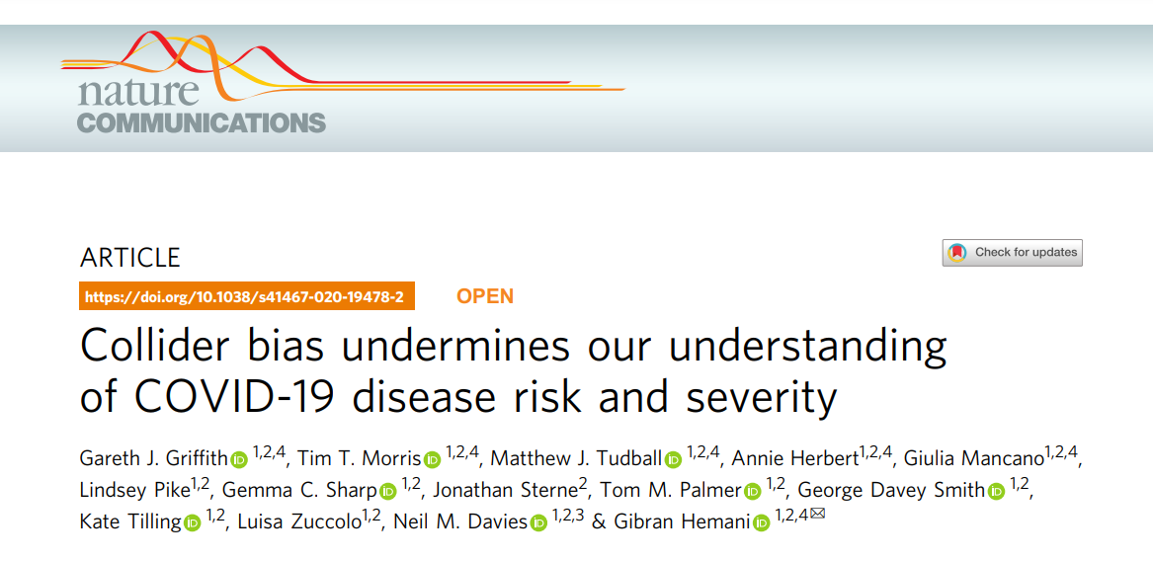
Collider Example
Pregnancy
induced association
COVID-19
COVID-19 Testing

Slide 46
Hypothesis Testing

Slide 47
Null vs Alternative
Hypothesis testing is a formal statistical procedure for deciding between two competing claims about a population parameter, in the example of a 2-sample t-test, the difference between two means
Null hypothesis - no real effect; apparent effects arose from random sampling
Alternative hypothesis - real effect; observed effects arose from a true difference

Slide 48
Null Hypothesis
(no difference between population means)
Alternative Hypothesis
(difference between population means)

Slide 49
Two-sample t-test
μcontrol = population mean of the control group
μtreated = population mean of the treated group
Null Hypothesis: H0: μcontrol = μtreated
Alternative Hypothesis: Ha: μcontrol ≠ μtreated

Slide 50
p-values

Slide 51
p-value
Definition: The p-value is the probability that with a treatment that has no real effect, we would observe an effect (positive or negative) as extreme as (or more extreme than) the one observed.
p-value is a quantitative measure of ‘how significant’ or ‘how confident’ you are that there is no effect
smaller p-value = stronger evidence against ‘no effect’

Slide 52
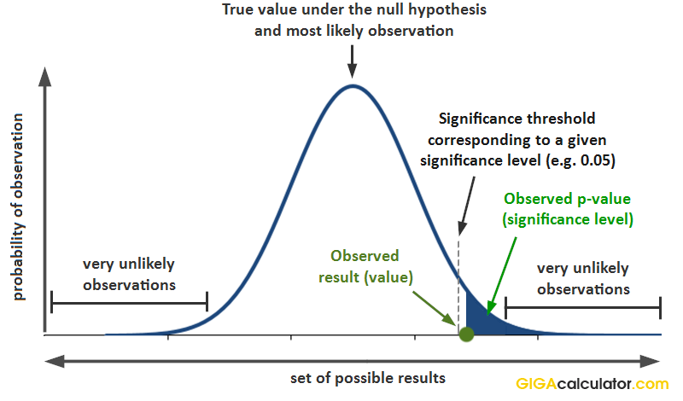
Null Distribution

Slide 53
Rejecting vs Failing to Reject the Null
You never PROVE the null
You can reject (i.e. significant results) or fail to reject (i.e. non-significant results), but a p-value > α is NOT saying the null is the true
Proof of impossibility or negative proof (e.g. proving something is absent)
Can’t prove something as you think, but you can prove the opposite is FALSE and this is why we have the null hypothesis
Makes discussions about non-significant results very difficult

Slide 54




p-value & Type I Error
p-value = probability of making a type I error when there is no true effect
Traditionally we are willing to accept a 5% chance of results occurring if the null is actually true (α < 0.05)
$$α$$
$$1− β$$
$$α$$
$$β$$
$$1 − α$$
$$β$$

Slide 55
Very Low p-values
Very low p-values are often suspect
NEVER report a p-value = 0
There is always some probability that you could get the result by chance
Instead report ‘p-value < 0.001’ or something

Slide 56
General Guidelines
A statistical results does not tell us what we should believe. It tells us how much we should change what we believe.
Non-significant: insufficient evidence to require any change
Significant (p<0.05): increase credence to a useful extent
Highly significant (p<0.001): increase credence markedly

Slide 57
Effect Sizes
Effect size (general) - quantitative measure of the magnitude of a phenomenon (https://en.wikipedia.org/wiki/Effect_size)
Standardized effect (size) – unitless measure that often incorporates error (e.g., Cohen’s d, correlation coefficient)
WARNING – statistical significance and clinically or biologically relevance are NOT the same thing

Slide 58
Why does effect size matter?
While statistical significance shows that an effect exists in a study, practical significance shows that the effect is large enough to be meaningful in the real world
Statistical significance alone can be misleading as it’s influenced by sample size. In contrast, effect sizes are independent if sample size

Slide 59
Effect size example
Question: does a new weight loss intervention perform better than an established intervention?
Study design: control intervention & experimental intervention (n=13,000 participants in each group)
After 6 months: mean weight loss for experimental intervention (mean = 10.6 lbs, sd = 6.7) was marginally higher than the control intervention (mean = 10.5 lbs, sd = 6.8). Resulted in a p-value = 0.01
Does an additional weight loss difference of 0.1 pounds really matter?

Slide 60
Power & Type II Error
power = probability of the detecting a true difference of a stated size
power = 1 - β
$$1− β$$
$$α$$
$$β$$
$$1 − α$$

Slide 61
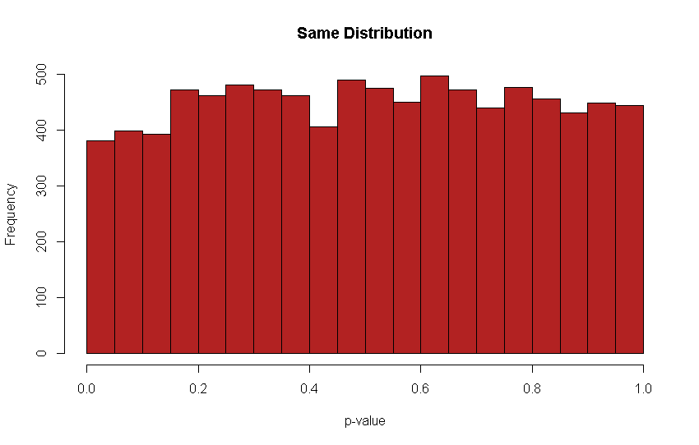
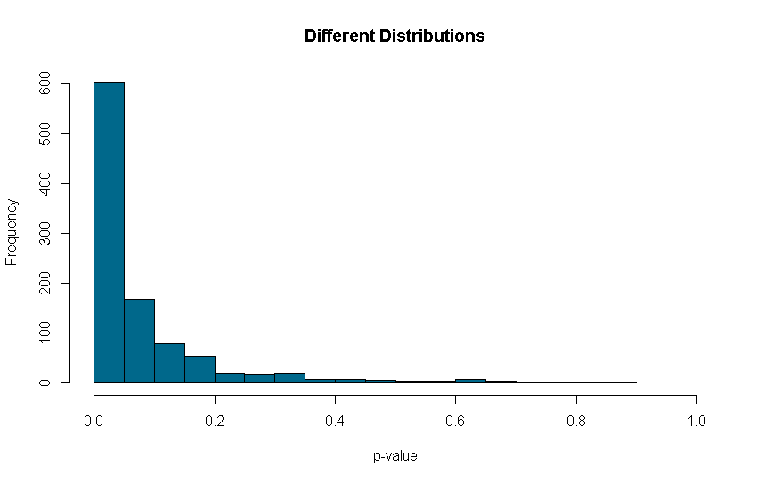
Power
Histogram of p-values from multiple t-tests sampling either from the same distribution or a different distribution
How large this peak is directly related to statistical power
FALSE POSITIVES
FALSE NEGATIVES

Slide 62
Power Calculations
5 components – need 4 and can solve for the missing component
Effect size
Variance
Significance Level (α)
Sample size (n)
Power (1 – β)
A priori power calculations always needed for grants
Never perform an observed or post-hoc power analysis, even if an editor requests it

Slide 63
Bayesian Statistics

Slide 64
Religions of Statistics
Two ‘religions’ in statistics - Frequentist vs. Bayesian
Frequentist - relies on p-values; most ‘accepted’; taught in most introductory textbooks; easy to apply and relies solely on the data collected
Bayesian - includes prior beliefs; relies on probability of being right (posterior probability) rather than probability of being wrong (p-value); requires advanced courses; harder to apply

Slide 65
Bayesian Statistics
Prior
+
Data
Posterior
3 steps to a Bayesian analysis for the effectiveness of a product:
Determine the ‘prior likelihood’ that the product is effective.
Use the new evidence from the trial to calculate how much to modify our prior view
Use exact mathematical rules to combine the prior likelihood with the new evidence to produce a ‘posterior likelihood’

Slide 66
Bayesian Statistics
Probability of a hypothesis being TRUE
No p-values, instead get credible intervals
Credible interval directly interprets the probability that the true value of a parameter lies within a specified range based on the data
Example: testing treatment of drug A vs drug B. 95% probability that treatment A is 10-20% more effective than drug B
Frequentist confidence intervals: probability that repeated samples would produce intervals containing the true value (i.e. confidence placed on interval itself instead of parameter)
Pro: results are more intuitive
Con: computationally intensive and need to be careful about priors

Slide 67
Conclusions

Slide 68
What Did We Learn?
Statistical inference quantifies the uncertainty in our conclusions related to patterns in the data.
Scope of inference forces us to think about who/what we want to/are able to extend our conclusions to.
In general, causal inference in only possible in randomized experiments
DAGs are used to illustrate the research question & summarize analytical strategy
Statistical hypotheses clearly state comparison we would like to make including the statistical parameter of interest.
p-values allow us to assign a quantitative value to how confident we are that there is no difference/effect. But this value should be combined with our prior knowledge (i.e. effect sizes)
p-values do NOT address how confident we are that we ‘right’

